Slide 1
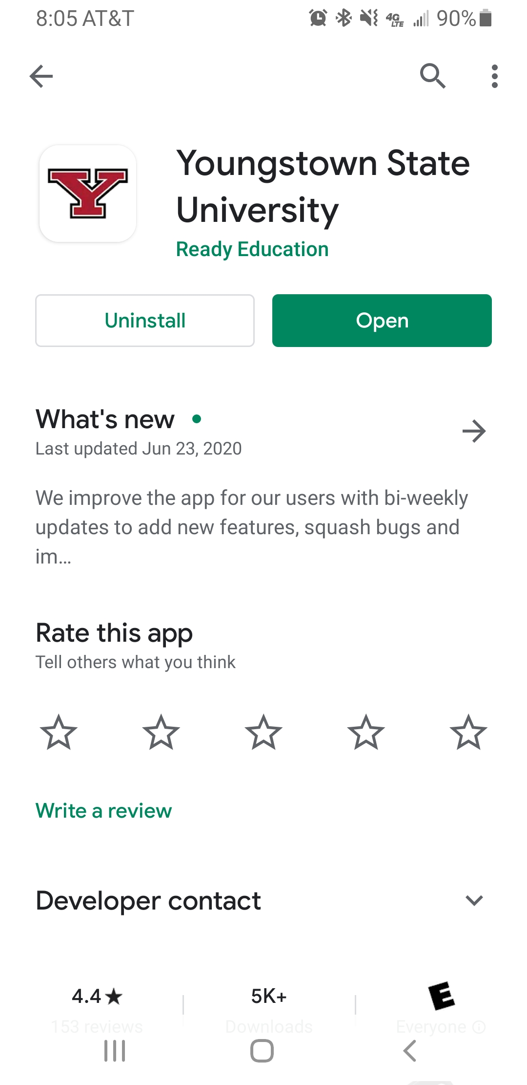
YSU APP

Slide 2
YSU APP
Existing resources on the YSU APP include:
YSU single sign on capability with the app, using existing YSU email ID
Course listing viewable from the app with building locations and directions
Ability to add YSU events and courses to Office 365 calendar
Updated list of all campus events and programs
Easy event and service check in
Quick access to contact YSU police
Academic Senate Podcast
Campus Directory
Upcoming enhancements to the app for this Fall are:
Native Blackboard Integration as well as direct Blackboard app access
CoVid-19 related resources and location check in
Virtual Y Card Integration
YouTube, Zoom, Teams & Hangouts preview in Campus Wall
Virtual event check -in (release date TBD)
Added calendar syncing with phone calendar

Slide 3
Scanning in on Campus
Students, faculty and staff are encouraged to scan in to classrooms and campus spaces they will be in for longer than 15 minutes to assist with CoVid 19 reporting and responding when necessary, and keeping our Penguins healthy.
Each classroom, meeting room, or lab will have a QR code at the entrance. Use the YSU App to scan before entering. The scanner is located on the YSU app upper corner.
Used for contract tracing not class room attendance at this time.

Slide 4
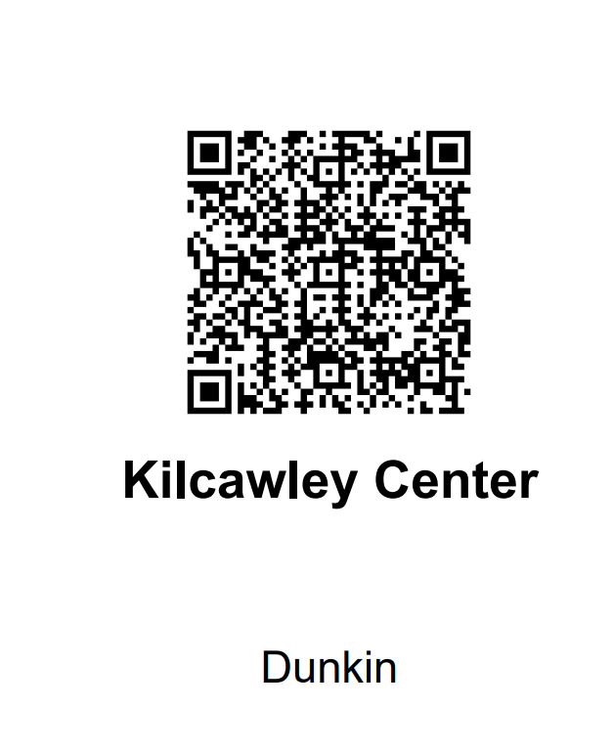
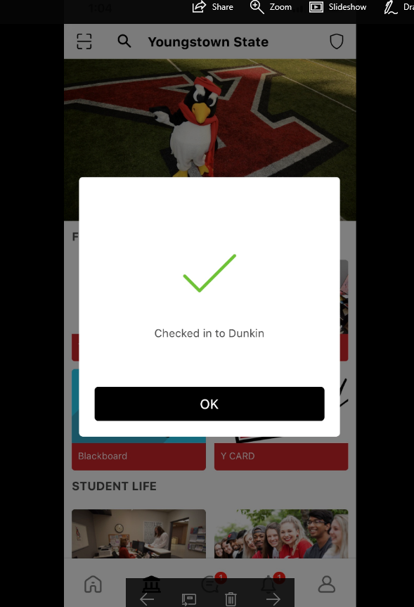
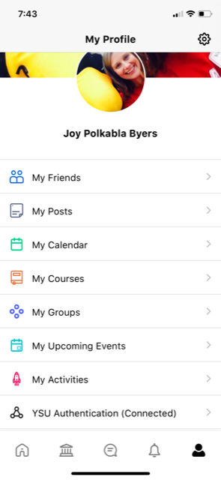
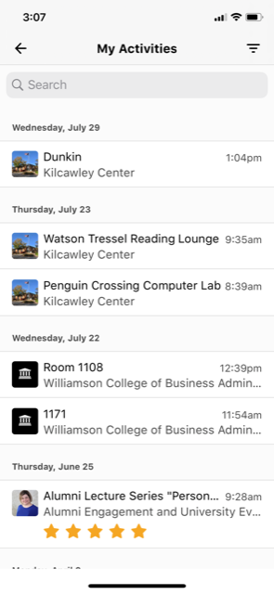
Using QR Codes

Slide 5
Issues with Scanning IN
QR Codes Labeled Covid Response with Building and room number
Located by cleaning supplies in each room
Tips for scanning In
Try again – Needs focused
WIFI challenges
Issues with scanning In - Please have them contact jlbyers@ysu.edu

